Slide 1

SVKM’s Institute of Technology, Dhule Department of Information Technology
Project Presentation
On
Vehicle Emissions Monitoring and Control using IOT
By
23 - Manish Shankarlal Makhija
59 - Ramandeepkaur Banvat
61 - Lokesh Dipak Patil
65 - Harshit Arun Gujarathi
Guide
Dr. Bhushan Chaudhari
Day and Date of Review : 2023

Slide 2
Contents
Project Group
Project Motivation
Project Title
Project abstract
Approach of our System
Components Required
Architecture
Literature Survey
Comparison of our System
References

Slide 3
Project Details
Project Title : Vehicle Emissions Monitoring and Control using IOT
Project Domain: IOT
Project Group Members:
T2154491246505 - Harshit Arun Gujarathi
T2054491246030 - Manish Shankarlal Makhija
T2054491246044 - Ramandeepkaur Banvat
T2054491246026 - Lokesh Dipak Patil

Slide 4

Motivation
Delhi Air Pollution: Smoke from Vehicles Worsens Air Quality, AQI Touches 40

Slide 5
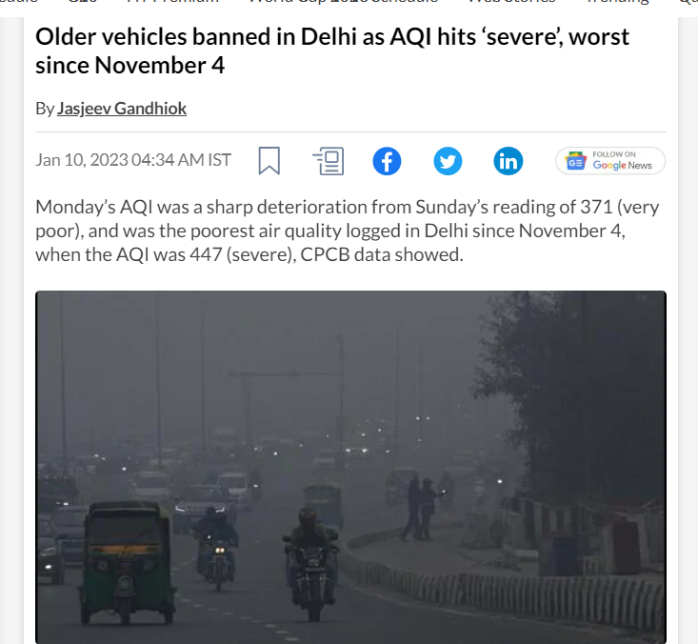
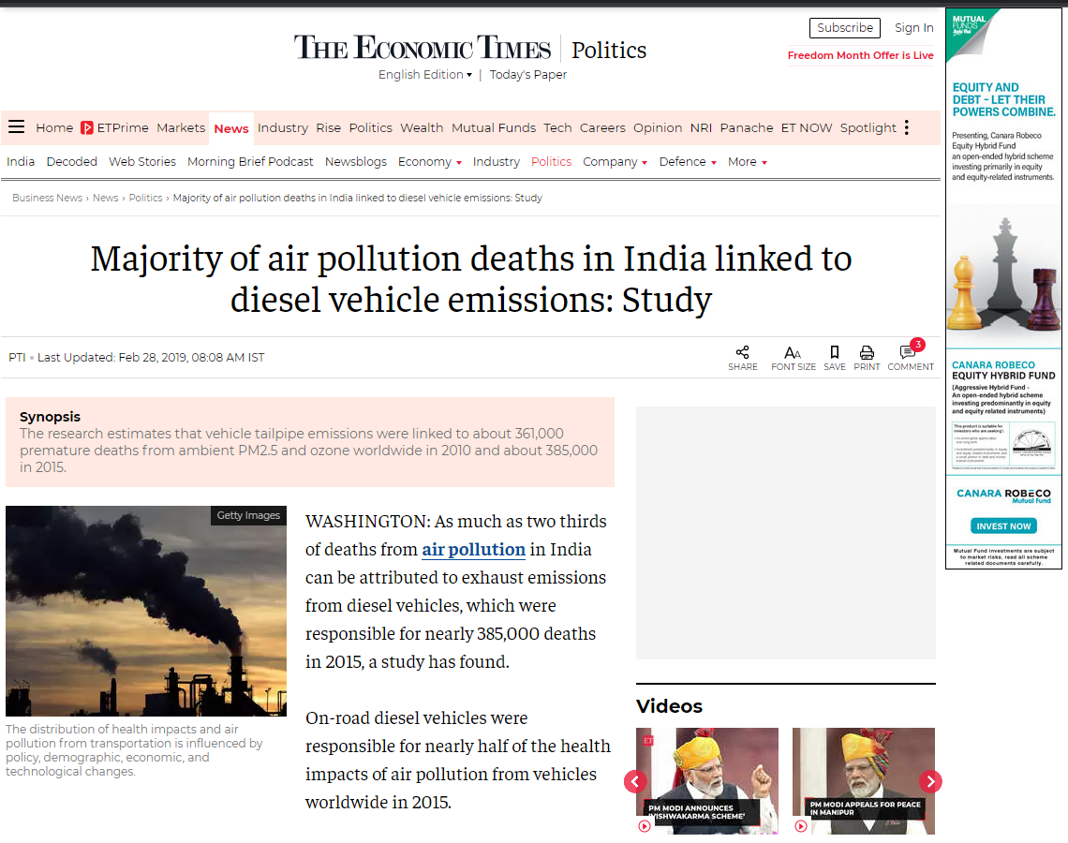
Two-Wheelers Cause Maximum Air Pollution in Delhi, Says Study.
Govt to Ban Old Vehicles in Delhi to Curb Air Pollution.

Slide 6
Problem Abstract
.
Problem: Vehicle emissions contribute to poor air quality and climate change.
Problem Description: Vehicle emissions are a major source of air pollution, and they contribute to a variety of health problems, including respiratory diseases, heart disease, and cancer. The problem is especially severe in densely populated areas, where air pollution can reach hazardous levels.
Problem Impact: Vehicle emissions have a significant impact on the environment and public health. They contribute to climate change, smog, and acid rain. They also make it difficult to breathe, especially for people with asthma and other respiratory problems.

Slide 7
APPROACH OF OUR TOPIC
The esp32 development kit is connected to the gas sensors (mq series)
TO RECEIVE THE CALIBRATE DATA
THE MOBILE APPLICATION IS CONNECTED WITH THE CLOUD TO SHOW THE READ DATA INTO PPM AND PERCENTAGE FORMAT
IF THE READ VALUE IS INCREASED AND CROSS THE LIMIT THE SERVICE NEEDED MESSAGE IS DISPLAYED
USING THINGSPEAK THE CALIBARATE DATA IS STORED

Slide 8
COMPONENT REQUIRED
Breadboard
ESP 32 Development board
MQ2 , MQ7 , MQ135 Sensors
Jumper wire (M-F)

Slide 9
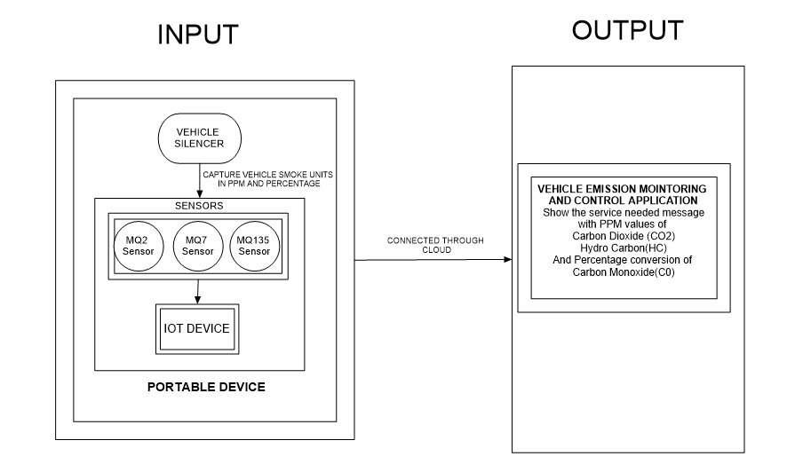
ARCHITECTURE

Slide 10
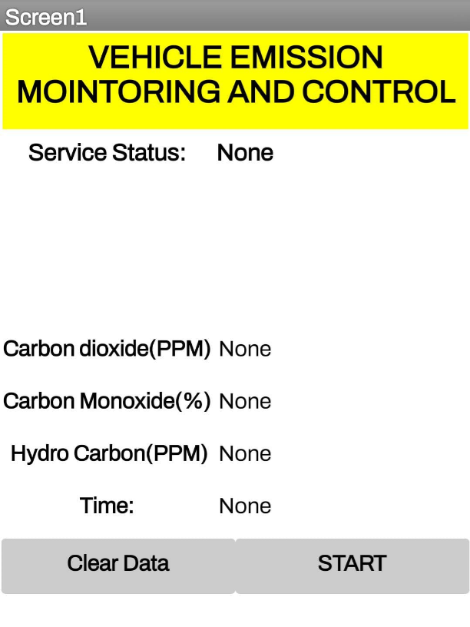
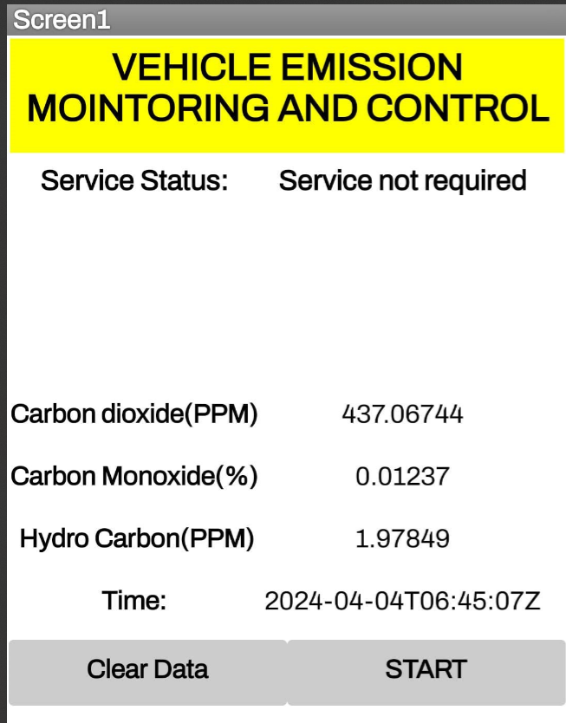
INTERFACE

Slide 11
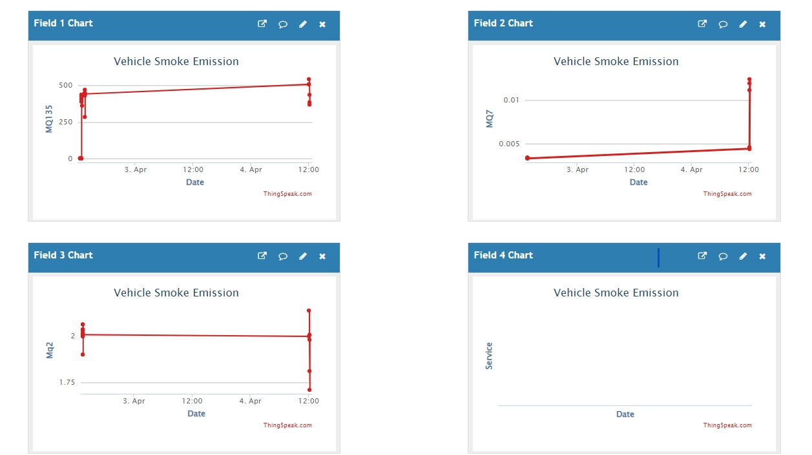
INTERFACE

Slide 12
Literature Survey
Reference No / Paper Title | Issues Found | Parameters/Tools used | Work Description
[3]Mr. Suthagar S, V. Uma, M. Sutha, V. Vijayarani, "Automated Monitoring and Control of Vehicles Based Air Pollution Level and Safety ".International Journal of Advanced Research Trends in Engineering and Technology (IJARTET) Vol. 4, Special Issue 19, April 2017. | This project aims to develop an automated system to monitor and control vehicle air pollution levels, using smoke sensors, a GSM module, and a vibration sensor for accidents. | Micro controller (AT89S52), Smoke sensor, RF ID reader, GSM, LCD display, Buzzer, Relay, Motor, Keypad, Vibration sensor, IR sensor | This system includes a buzzer that activates when pollution levels exceed a set threshold and automatically shuts down the vehicle if emissions continue. The owner must service the vehicle for reactivation. Other features include one-time passwords, IR sensors for helmet detection, and vibration sensors for accident indication. Overall, this project aims to promote vehicle safety and reduce air pollution.
[5]Bharathraj P, Arun Prasad V S, Aswin Kumar M, Shyamalaprasanna A, 2022, Vehicle Pollution Monitoring System using IoT, International Journal Of Engineering Research & Technology (IJERT) NCICCT – 2022 (Volume 10 – Issue 05) | The research paper lacks detailed explanations and examples in key areas such as the long-term income consequences of electric vehicles, expenses related to innovation adoption, and the need for precise monitoring techniques. | Node MCU, MQ2 Gas Sensor , Temperature | The document outlines the development of a Vehicle Pollution Monitoring System that uses IoT technology to monitor carbon dioxide emissions and send warnings using a GSM module and an LCD display.

Slide 13
Literature Survey
[6]"Low Cost CO Detector Integrated with IoT" and was authored by Emmanuel Estrada, Miriam Moreno, Karina Martín, Álvaro Lemmen Meyer, P.M. Rodrigo, and Sebastián Gutiérrez. It was published by the Universidad Panamericana Aguascalientes in Mexico. The document was downloaded from IEEE Xplore on August 22, 2023. | The low-cost CO detector may have fewer features compared to more expensive alternatives. It might lack advanced sensors or integration with other smart home systems. | MQ7, MCU ESP2866, Active Buzzer, LED, ESP32 IDE. | This project focuses on monitoring and detecting harmful CO concentrations in the air using an ESP8266 microcontroller, MQ-7 sensor, buzzer, and LED, with real-time CO level display on a mobile device via the Blynk app. It emphasizes affordable solutions and encourages creative approaches to mitigate health risks.
[7]Priyanka.R."Vehicle pollutants control using sensors and ESP32." 2017 Third International Conference on Sensing, Signal Processing and Security (ICSSS). IEEE, 2017. | The system only monitors and controls three pollutants (CO2, CO, and hydrocarbons) and may not provide a comprehensive solution to vehicle pollution, as there are many other harmful pollutants emitted by vehicles. | Sensors, an ESP32 board, a GSM module, and the IBM Watson IoT platform. | The proposed methodology uses sensors and ESP32 technology to control vehicle pollutants. When emission levels exceed a threshold, an alarm is triggered and data is sent to the IBM Watson IoT platform via a GSM module, allowing the Pollution Control Board to monitor and reduce emissions.

Slide 14
Comparison with our System
Constraints | Existing System | Our System
Device | Netel NPM-SM-111B Diesel PUC Smoke Meter Netel NPM-MGA-1 Auto Exhaust Multigas Analyzer | ESP 32 Development board MQ2 , MQ135 , MQ7 Sensors. Jumper wire (M-M)
Weight | Heavyweight | Lightweight
Portability | Not Portable | Portable
Device Outcome Value | Static Time Value | Runtime Value
Price | 5 Lakh /- | 1500 /-
System Support | Web portal | Mobile Application

Slide 15
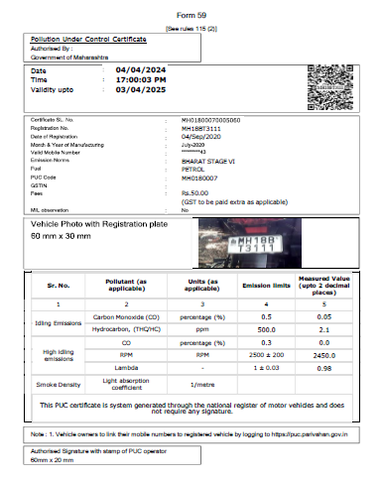

Slide 16
Conclusion
Integration of MQ2, MQ7, and MQ135 sensors into vehicle emission monitoring via IoT and ESP32 WiFi.
Enables accurate ppm measurement of CO2, HC, and CO emissions in percentage.
Multi-sensor setup enhances monitoring capabilities, providing valuable insights for pollution control measures.
ESP32 microcontroller ensures seamless data transmission and communication between vehicles and monitoring stations.
Real-time monitoring facilitated for prompt environmental action.
Availability of ppm data enables precise assessment of vehicle emissions.
Facilitates proactive measures to mitigate environmental impact.

Slide 17
References
Kumaran, S., Arunachalam, S., Surendar, V., & Sudharsan, T. (2023, February). ”IoT-based Smoke Detection with Air Temperature and Air Humidity; High Accuracy with Machine Learning”. In 2023 Third International Conference on Artificial Intelligence and Smart Energy (ICAIS) (pp. 604-610),IEEE.
Kshirsagar, P. R, Manoharan, H, Al-Turjman, F & Maheshwari,K. K. (2020). ”Design and testing of automated smoke monitoring sensors in vehicles”. IEEE Sensors Journal, 22(18), 17497-17504.
Riegel, J, H. Neumann, and H-M. Wiedenmann. ”Exhaust gas sensors for automotive emission control.” Solid State Ionics 152 (2022): 783-800.
Bharathraj P, Arun Prasad V S, Aswin Kumar M, Shya- malaprasanna A, 2022, ”Vehicle Pollution Monitoring System using IoT, INTERNATIONAL JOURNAL OF ENGINEERING RESEARCH & TECHNOLOGY”, (IJERT) NCICCT – 2022 (Volume 10 – Issue 05).
”Low-Cost CO Detector Integrated with IoT” was authored by Emmanuel Estrada, Miriam Moreno, Karina Mart´ın, A´ lvaro Lemmen Meyer, P.M. Rodrigo, and Sebastia´n Gutie´rrez. It was published by the Universidad Panamericana Aguascalientes in Mexico, IEEE Xplore on August 22, 2023.
R. Akhila, B. Amoghavarsha, B. Karthik, Y. Prajwal and Ba- jarangbali, ”Internet of Things based Detection and Analy- sis of Harmful Vehicular Emissions,” 2022 4th International Conference on Smart Systems and Inventive Technology (IC- SSIT), Tirunelveli, India, 2023, pp. 630-636, doi: 10.1109/IC- SSIT53264.2022.9716558..
D. Kandris, C. Nakas, D. Vomvas, and G. Koulouras, “Applications 591 of wireless sensor networks: An up-to-date survey,” Appl. Syst. Innov., 592 vol. 3, no. 1, pp. 1–24, Mar. 2022. 593
S. Ullo et al., “Application of wireless sensor networks to environmental 594 monitoring for sustainable mobility,” in Proc. IEEE Int. Conf. Environ. 595 Eng. (EE), Mar. 2022, pp. 1–7. 596.
S. Kaivonen and E. C.-H. Ngai, “Real-time air pollution monitoring with 597 sensors on city bus,” Digit. Commun. Netw., vol. 6, no. 1, pp. 23–30, 598 Feb. 2023. 599.
L. Andrea, R. Abirami, M. Diviya, and J. S. Nancy, “Framework for fire 605 detection and mitigation using IoT,” Int. J. Pure Appl. Math., vol. 118, 606 no. 18, pp. 1801–1811, 2018. 607

